Slide 1
Cryptosystem

Slide 2
Encryption
Constrains the set of possible receivers of a message
Encryption algorithm consists of
Set K of keys
Set M of Messages
Set C of ciphertexts (encrypted messages)
A function E : K → (M→C). That is, for each k ∈ K, E_{k} is a function for generating ciphertexts from messages
Both E and E_{k} for any k should be efficiently computable functions
A function D : K → (C → M). That is, for each k ∈ K, D_{k} is a function for generating messages from ciphertexts
Both D and D_{k} for any k should be efficiently computable functions

Slide 3
Encryption (Cont.)
An encryption algorithm must provide this essential property: Given a ciphertext c ∈ C, a computer can compute m such that E_{k}(m) = c only if it possesses k
Thus, a computer holding k can decrypt ciphertexts to the plaintexts used to produce them, but a computer not holding k cannot decrypt ciphertexts
Since ciphertexts are generally exposed (for example, sent on the network), it is important that it be infeasible to derive k from the ciphertexts

Slide 4
Symmetric Encryption
Same key used to encrypt and decrypt
Therefore k must be kept secret
DES was most commonly used symmetric block-encryption algorithm (created by US Govt)
Encrypts a block of data at a time
Keys too short so now considered insecure
Triple-DES considered more secure
Algorithm used 3 times using 2 or 3 keys
For example
2001 NIST adopted new block cipher - Advanced Encryption Standard (AES)
Keys of 128, 192, or 256 bits, works on 128 bit blocks
RC4 is most common symmetric stream cipher, but known to have vulnerabilities
Encrypts/decrypts a stream of bytes (i.e., wireless transmission)
Key is a input to pseudo-random-bit generator
Generates an infinite keystream

Slide 5
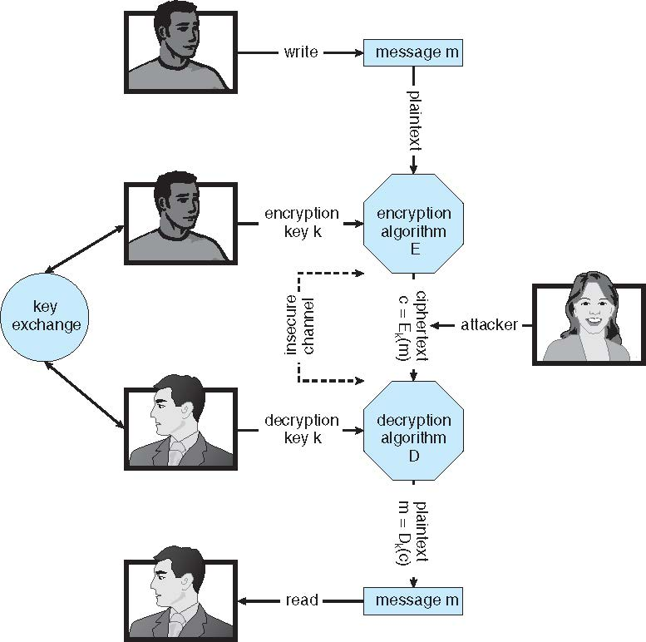
Secure Communication over Insecure Medium

Slide 6
Asymmetric Encryption
Public-key encryption based on each user having two keys:
public key – published key used to encrypt data
private key – key known only to individual user used to decrypt data
Must be an encryption scheme that can be made public without making it easy to figure out the decryption scheme
Most common is RSA block cipher
Efficient algorithm for testing whether or not a number is prime
No efficient algorithm is know for finding the prime factors of a number

Slide 7
Asymmetric Encryption (Cont.)
Formally, it is computationally infeasible to derive k_{d,N} from k_{e,N}, and so k_{e} need not be kept secret and can be widely disseminated
k_{e} is the public key
k_{d} is the private key
N is the product of two large, randomly chosen prime numbers p and q (for example, p and q are 512 bits each)
Encryption algorithm is E_{ke,N}(m) = m^{ke} mod N, where k_{e} satisfies k_{e}k_{d} mod (p−1)(q −1) = 1
The decryption algorithm is then D_{kd,N}(c) = c^{kd} mod N

Slide 8
Asymmetric Encryption Example
For example. make p = 7and q = 13
We then calculate N = 7∗13 = 91 and (p−1)(q−1) = 72
We next select k_{e} relatively prime to 72 and< 72, yielding 5
Finally, we calculate k_{d} such that k_{e}k_{d} mod 72 = 1, yielding 29
We how have our keys
Public key, k_{e,N} = 5, 91
Private key, k_{d,N} = 29, 91
Encrypting the message 69 with the public key results in the cyphertext 62
Cyphertext can be decoded with the private key
Public key can be distributed in cleartext to anyone who wants to communicate with holder of public key

Slide 9
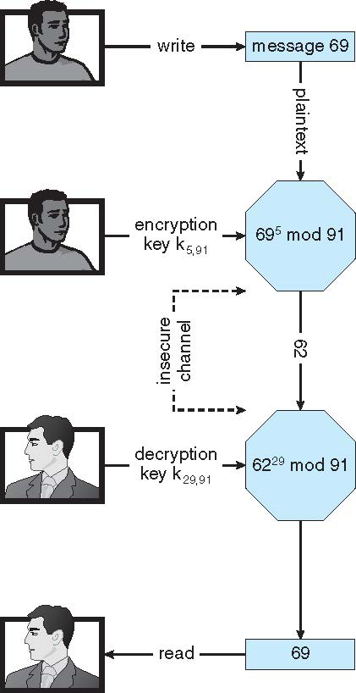
Encryption using RSA Asymmetric Cryptography

Slide 10
Cryptography (Cont.)
Note symmetric cryptography based on transformations, asymmetric based on mathematical functions
Asymmetric much more compute intensive
Typically not used for bulk data encryption

